Slide 1


Technical Presentation
Analysis and Prediction on SupplyChain Dataset
Presented by
Devansh Bolsure
Ajinkya Kank
1

Slide 2
Introduction
-This is a Machine Learning project in which we hava done analaysis on SupplyChain data and Prediction on Late_Delivery_Risk
-For Analysis we have used Tableau
-for predicition we have use Logistic Regression, SVM(Support Vector Machine), SNN(Simple Neural Network)
2

Slide 3
Problem Statement
Late deliveries negatively impact customer satisfaction and business performance.
- The lack of predictive insights makes it difficult to anticipate late deliveries and mitigate risks.
3

Slide 4
Objective
Develop a machine learning model to predict late delivery risks.
Analyze supply chain performance using Tableau to identify key patterns.
- Identifying key factors affecting deliveries
4

Slide 5
Technology used
Python
jupyter Notebook
Tableau
Pandas
Numpy
Tenserflow
Scikit-learn
5

Slide 6
Methodology
Data Collection & Exploratory Data Analysis
Data
Pre-processing & Cleaning
Data Analysis & Visualization (Tableau)
Using Machine Learning Models for Late Delivery Prediction.
6

Slide 7
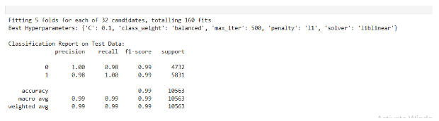
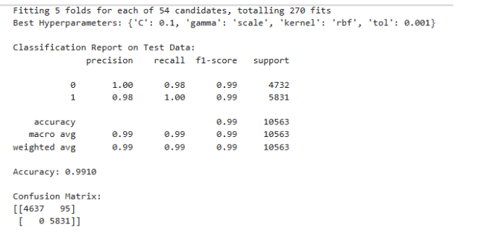
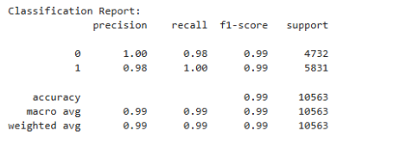
Predicting Late Delivery Risk (ML Model)
Logistic Regression:
Predicts probability of late delivery.
Interpretable model with feature importance.
Evaluated using accuracy, precision, recall, and F1-score.
Support Vector Machine (SVM):
Identifies complex patterns in delivery risk.
Optimized with GridSearchCV for best hyperparameters.
Evaluated using classification report and confusion matrix.
7

Slide 8
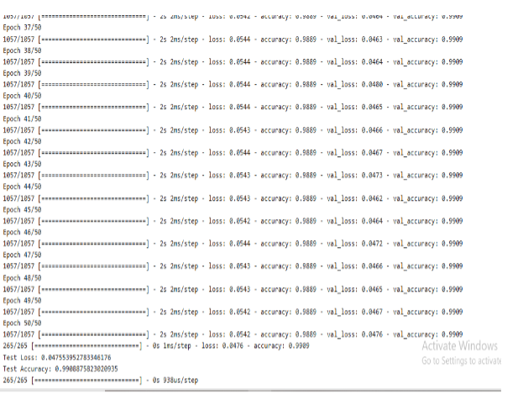
Predicting Late Delivery Risk (ML Model)
Neural Network (Deep Learning)
Uses multiple hidden layers to learn complex relationships.
StandardScaler applied for feature normalization.
Trained with 50 epochs for accuracy improvement.
8

Slide 9
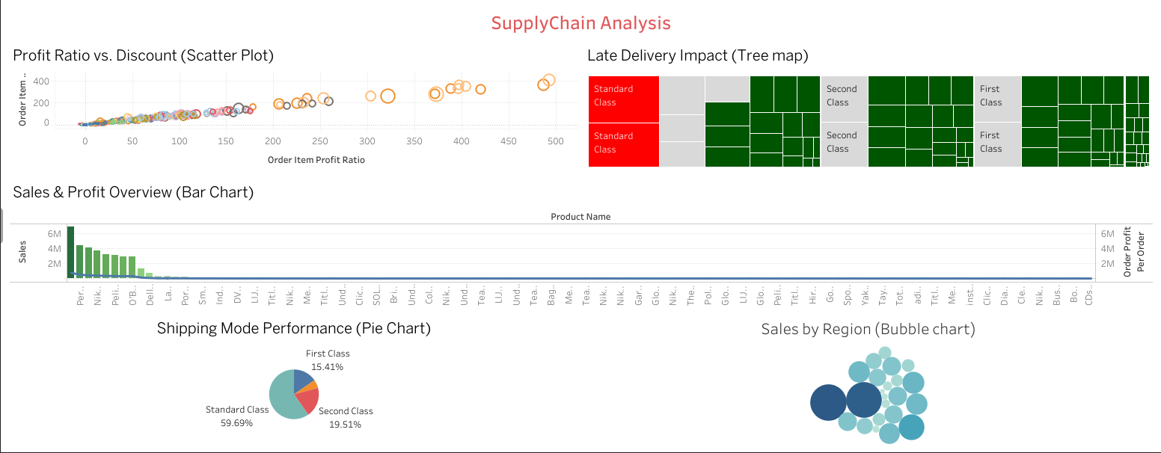
Supply Chain Analysis in Tableau
9

Slide 10
Conclusion & Q&A
Project Summary:
Successfully predicted late delivery risks.
Gained insights from supply chain data.
Any Question ?
Load the Data theCreate Table Write Query & Execute it
10

Slide 11
Technical Presentation
THANK YOU
11

